Slide 1
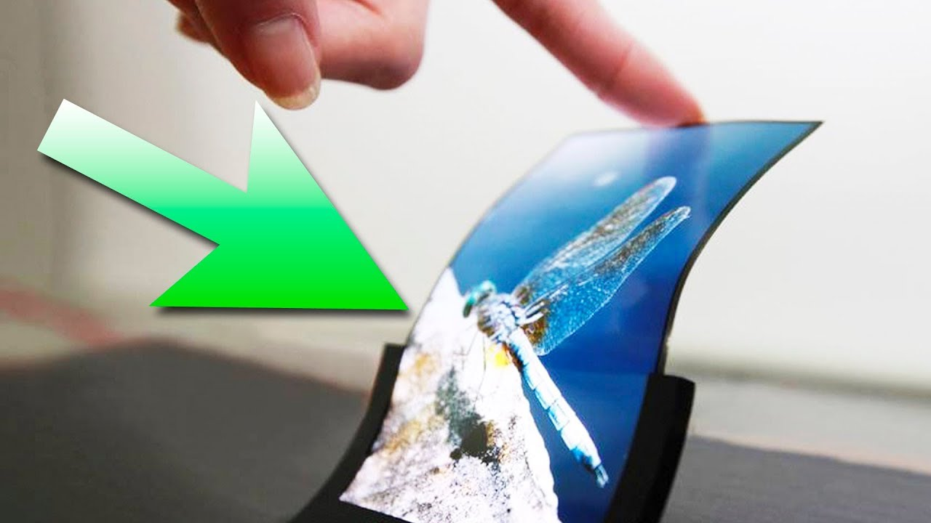
A Study Report on OLED Display
Contents
1: Introduction
2: Working Principle of OLED Display
3: Types of OLED Layers
4.Types of OLED Displays
5: structure stacking of OLED panel module.
6.Advantages of OLED Displays
7.: Applications of OLED Displays
Prepared By -
Vrishven kumar

Slide 2
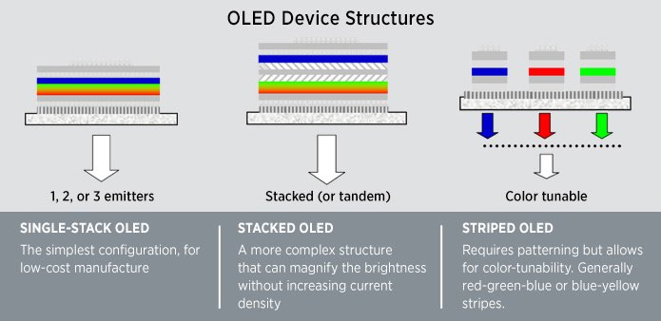
1: Introduction
An OLED is a solid-state device consisting of a thin, carbon-based semiconductor layer that emits light when electricity is applied by adjacent electrodes. In order for light to escape from the device, at least one of the electrodes must be transparent. The intensity of the light emitted is controlled by the amount of electric current applied by the electrodes, and the light's color is determined by the type of emissive material used. To create white light, most devices use red, green, and blue emitters that can be arranged in several configurations, as illustrated below.

Slide 3
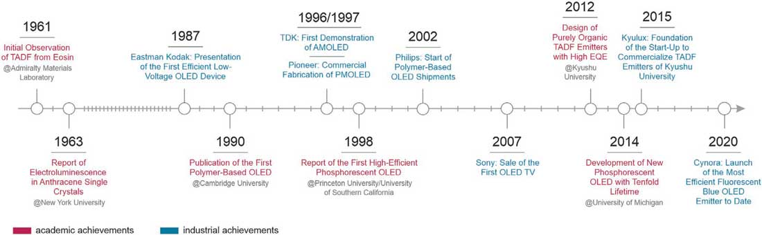
1.1 Brief history and evolution of OLED displays.
Active research and development of OLEDs (organic light emitting diodes) started in 1987, when Tang and VanSlyke of Eastman Kodak showed that a bright luminance was obtained in an OLED device with two thin organic layers sandwiched between anode and cathode.
OLED devices have come forward based on three generations of emitter materials relying on fluorescence (first generation), phosphorescence (second generation), and thermally activated delayed fluorescence (third generation).

Slide 4
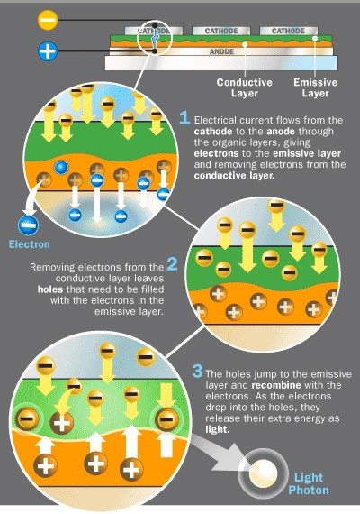
2: Working Principle of OLED Display

Slide 5
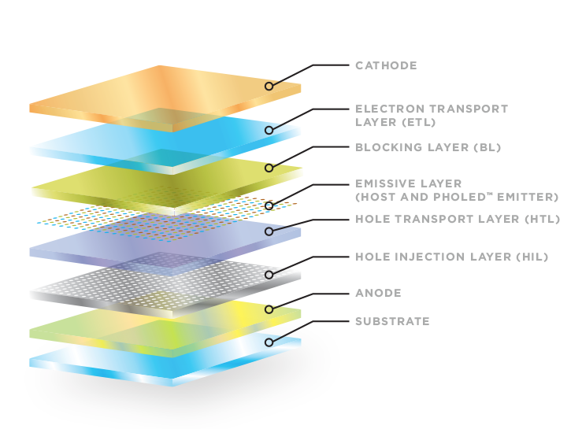
3.Different layers of the OLED

Slide 6
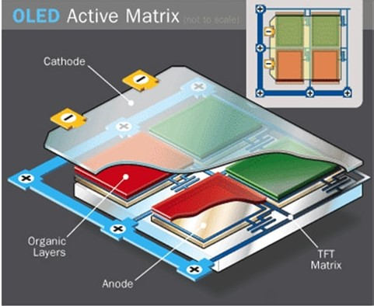
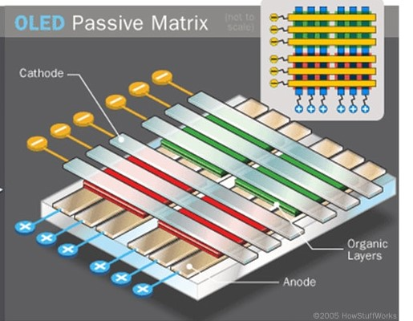
4.Types of OLED Displays
4.1 AMOLED (Active Matrix OLED):
AMOLED cells contain organic molecule layers and anodes arranged in small sheets (pixels), sandwiched between a larger cathode sheet and integrated into a TFT (thin film transistor) matrix. The TFT matrix not only acts as the supporting substrate; it also controls which pixels become activated by switching on or off current flow to the appropriate pixels and hence drives them in a similar manner to TFT LCD monitors. The typical layout of such a cell is shown below, again with only two pixel colours for diagrammatic purposes.
4.2 PMOLED (Passive Matrix OLED):
Passive-matrix OLED (PMOLED) screens consist of cells with opaque cathodes and transparent anodes laid perpendicular to one another in strips. Between these strips are the organic layers of alternate coloured light-emitting diodes and conductive molecules. Once power is switched on to external circuitry (voltage is applied), current flows through particular cathode and anode strips, so that light of selected colours and brightness are emitted through the electrode intersections according to the molecules illuminated and current applied (respectively).

Slide 7
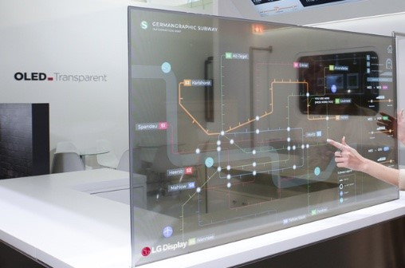
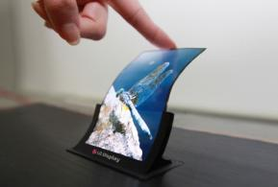
4.Types of OLED Displays
4.3 Transparent OLED:
These displays are made with transparent components, allowing light to pass through when the display is turned off. Transparent OLEDs are often used in augmented reality (AR) and heads-up display (HUD) applications . Transparent OLED screens are made up of millions of pixels that each emit their own individual light. This opens up a whole new field of creativity in digital signage that even transparent LCD screens cannot offer.
4.4 Flexible OLED:
Flexible OLED displays are built on flexible substrates, such as plastic, instead of rigid glass. This allows them to be bent or curved, opening up possibilities for innovative form factors in smartphones, wearables, and other devices.

Slide 8
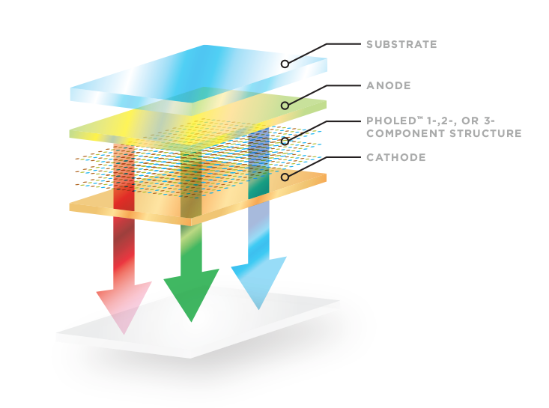
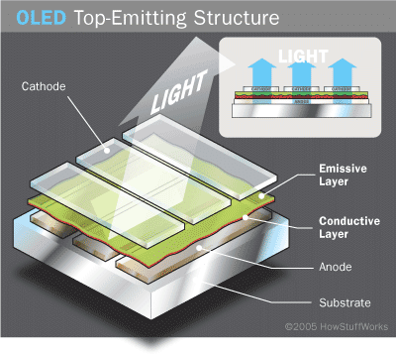
4.Types of OLED Displays
4.5 White OLED (WOLED):
WOLED displays use a combination of red, green, and blue OLED materials to create white light. They offer improved efficiency and color consistency compared to traditional OLED displays, making them suitable for high-end TVs and lighting applications.
4.6 Top-Emitting OLED:
In top-emitting OLED displays, light is emitted from the top side of the device, allowing for higher brightness levels and improved efficiency. These displays are commonly used in larger OLED panels, such as TVs and monitors.

Slide 9
5.Structure stacking of OLED panel module.
The structure and stacking of OLED panel modules can vary depending on the specific application and requirements of the device. However, here is a generalized overview of the typical layers and stacking arrangement found in OLED panel modules:
5.1 Substrate:
The substrate is the base layer upon which the OLED panel is built. It is usually made of glass or plastic. Glass substrates are more common for rigid OLED displays, while plastic substrates are used for flexible OLED displays.
5.2 Anode Layer:
The anode layer is typically made of transparent conductive material such as indium tin oxide (ITO). It serves as the positive electrode, through which electric current flows into the OLED layers.
5.3 Organic Layers:
The organic layers are the heart of the OLED technology. These layers consist of organic (carbon-based) materials that emit light when an electric current passes through them. The organic layers typically include:
5.3.1 Hole Transport Layer (HTL):
This layer facilitates the transport of positive charge carriers (holes) from the anode to the emissive layer.
5.3.2 Emissive Layer:
This layer contains the organic materials that emit light when excited by the passage of electrical current. Different organic materials are used to emit different colors of light (red, green, blue).

Slide 10
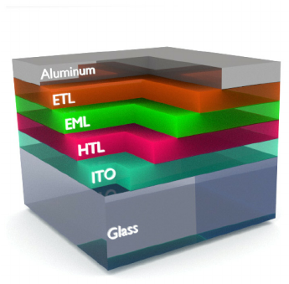
5.Structure stacking of OLED panel module.
5.3.3 Electron Transport Layer (ETL):
This layer facilitates the transport of negative charge carriers (electrons) from the cathode to the emissive layer.
5.4 Cathode Layer: The cathode layer is typically made of a material with low work function, such as aluminum or calcium. It serves as the negative electrode, through which electric current exits the OLED layers.
5.5 Encapsulation Layer: The encapsulation layer is essential for protecting the organic layers from exposure to moisture and oxygen, which can degrade OLED performance over time. It is typically made of thin film materials such as glass or metal deposited using techniques like atomic layer deposition (ALD) or chemical vapor deposition (CVD).
5.6 Barrier Layer (if applicable): In some OLED panel modules, especially those intended for flexible or foldable displays, an additional barrier layer may be included to provide extra protection against moisture and mechanical stress.

Slide 11
6: Advantages of OLED Displays
6.1 Improved Picture Quality:
OLED displays deliver vibrant colors, deep blacks, and high contrast ratios, resulting in superior picture quality compared to LCD displays. Each pixel in an OLED display emits its own light, allowing for precise control of brightness and color.
6.2 Thin and Lightweight:
OLED panels are made up of thin layers of organic materials, making them significantly thinner and lighter than LCD panels. This thinness enables manufacturers to create sleek and stylish devices with slimmer profiles.
6.3 Flexible and Bendable:
OLED technology allows for flexible and bendable displays, enabling innovative form factors such as curved screens and foldable devices. This flexibility opens up new possibilities for product design and user experiences.
6.4 Fast Response Time: OLED displays have faster response times compared to LCD displays, resulting in smoother motion and reduced motion blur, especially in fast-paced content such as gaming and sports.
6.5 Wide Viewing Angles: OLED displays maintain consistent color and brightness levels even when viewed from extreme angles, providing a better viewing experience for multiple viewers in various environments.

Slide 12
6: Advantages of OLED Displays
6.6 Energy Efficiency:
OLED displays consume less power compared to traditional LCD displays because they do not require a separate backlight. OLED pixels emit light directly when activated, leading to energy savings, especially in dark scenes where black pixels remain unlit.
6.6 Better Durability:
OLED displays are less prone to damage from water and dust compared to LCD displays because they do not have a backlight unit. Additionally, OLED panels are less susceptible to screen burn-in, a common issue with some types of LCD displays.
6.7 Environmentally Friendly:
OLED displays use organic materials that are more environmentally friendly compared to the heavy metals used in some LCD panels. Additionally, OLED technology can potentially be more energy-efficient, further reducing its environmental impact.

Slide 13
7: Applications of OLED Displays
OLED (Organic Light Emitting Diode) technology has found applications across various industries due to its unique characteristics and advantages
7.1 Smartphones:
OLED displays are widely used in smartphones due to their vibrant colors, deep blacks, and thin form factor. They offer superior picture quality and energy efficiency compared to LCD displays, making them the preferred choice for many flagship smartphones.
7.2Televisions:
OLED TVs deliver unparalleled picture quality with true blacks, high contrast ratios, and wide viewing angles. They are increasingly popular for home entertainment systems, providing an immersive viewing experience for movies, TV shows, and gaming.
7.3 Wearable Devices:
OLED displays are well-suited for wearable gadgets such as smartwatches, fitness trackers, and augmented reality (AR) glasses. Their flexibility, thinness, and low power consumption make them ideal for compact and lightweight devices worn on the body.

Slide 14
7: Applications of OLED Displays
7.4 Automotive Displays:
OLED displays are being integrated into automotive dashboards, infotainment systems, and instrument clusters. They offer high visibility in various lighting conditions, along with the ability to create curved or flexible display surfaces to fit into different car designs.
7.5 Virtual Reality (VR) and Augmented Reality (AR):
OLED displays are used in VR headsets and AR devices to provide immersive visual experiences. Their fast response times, high refresh rates, and high pixel density contribute to reduced motion sickness and enhanced realism in virtual environments.
7.6 Medical Devices: OLED displays are used in medical devices such as patient monitors, diagnostic equipment, and wearable health trackers. Their high-quality imaging capabilities and low power consumption make them suitable for medical applications where accuracy and efficiency are critical.
7.7 Lighting Solutions: OLED technology is also employed in lighting applications, including architectural lighting, automotive lighting, and decorative lighting. OLED lighting panels offer soft, diffused light with customizable shapes and colors, enabling creative and energy-efficient lighting designs.

Slide 15


